Slide 1
PRESENTATION BY SHAH AND STEVEN
NEW FREEZER CREAMERY
7
N
ESTABLISHED 2017

Slide 2
MISSION STATEMENT
We are a modern creamery that serves fresh, delicious ice cream made to order using liquid Nitrogen.
So not only is our ice cream rich and creamy but our on the spot process to make ice helps preserves the vitamin and calcium in the milk we use.
We also noticed that there is a lack of stores (outside of bars and clubs and few fast food restaurants) that are open late at night. We hope to capitalize on this potential market

Slide 3
Competition
In the liquid nitrogen ice cream industry we have a few competitors which include
Creamistry
a la minute
Sub zero
The ice cream way

Slide 4
About Our Store
Our store is located fountain valley
We will only serve one standard size ice cream of 8 ounces($6.50)
We will only offer 8 flavors as not to over complicate our menu.
It will consist of three freezing station,and each station comes with a mounted mixer. Each mixer cost $2500.
We’ll also buy retails sweets and resell our side such as cookies, brownie and macaroons
Open from 3pm - 3am as to capture our high school-college target audience

Slide 5
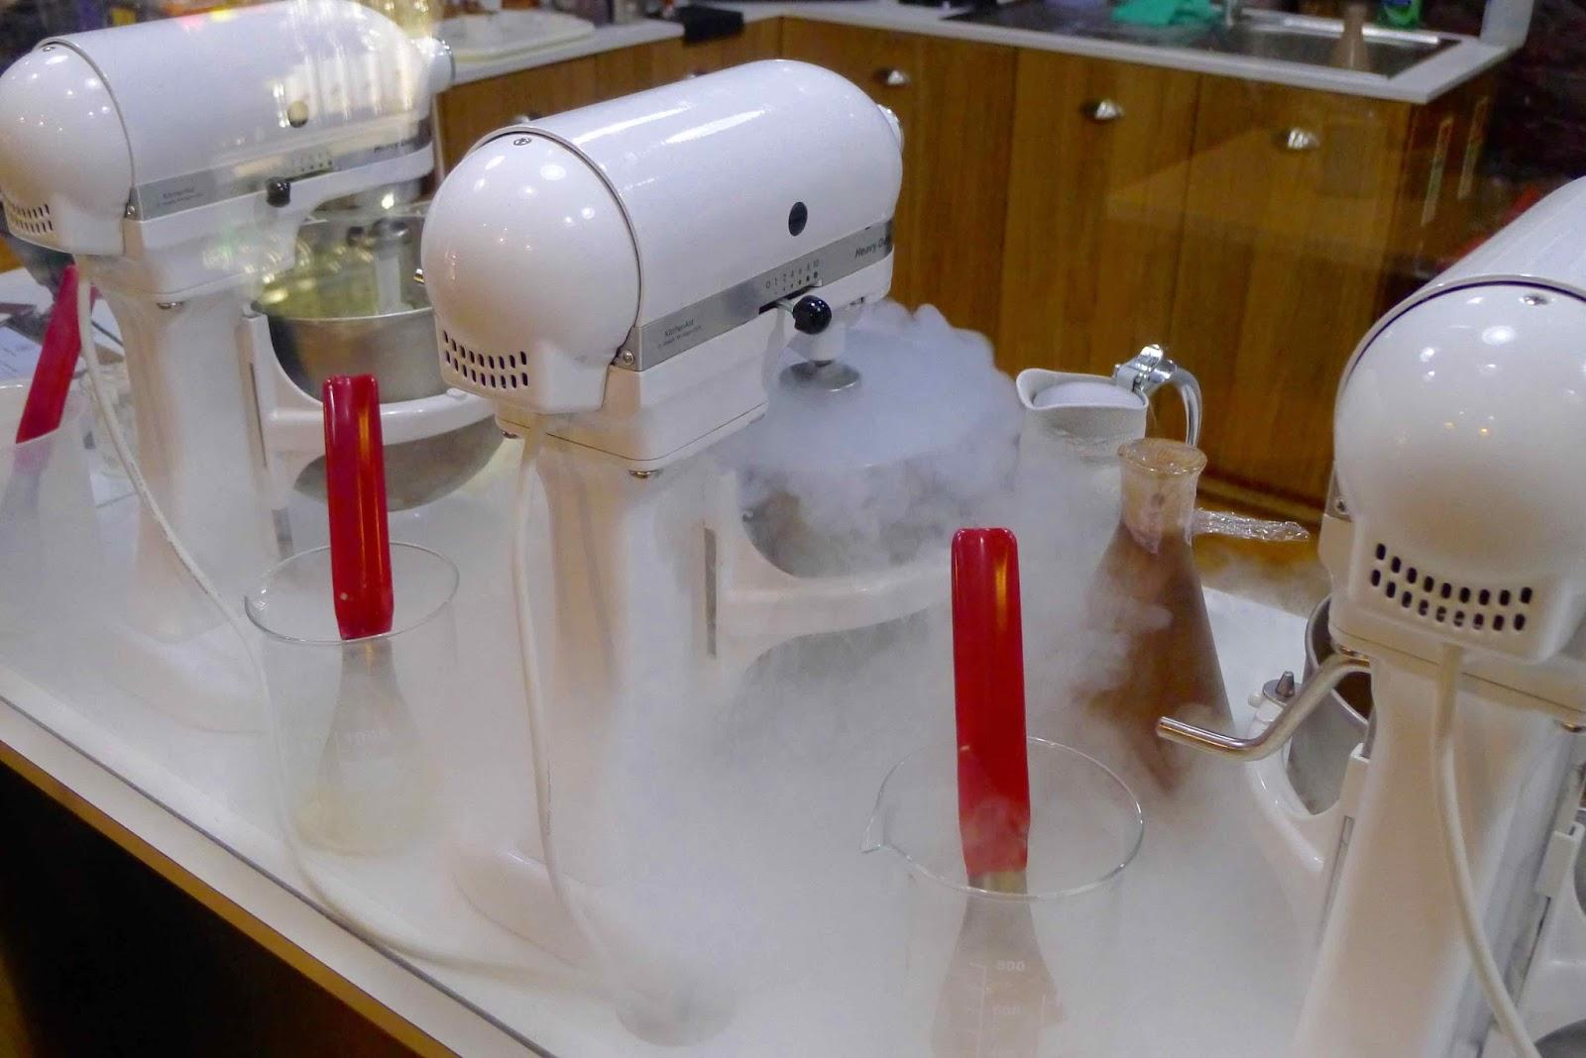
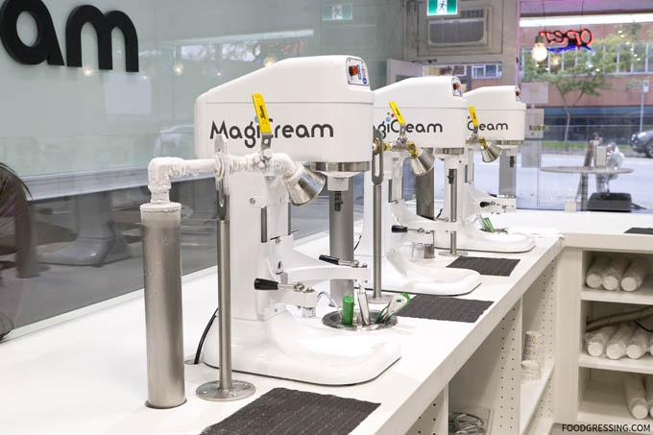
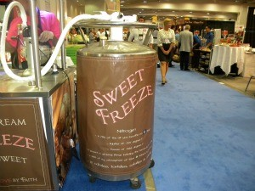

Slide 6
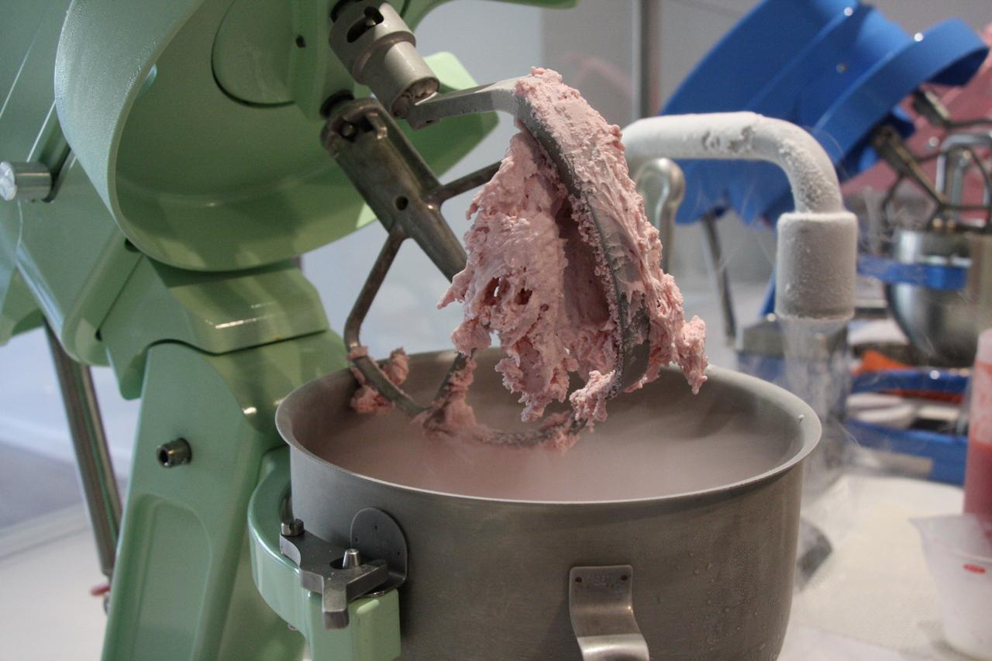
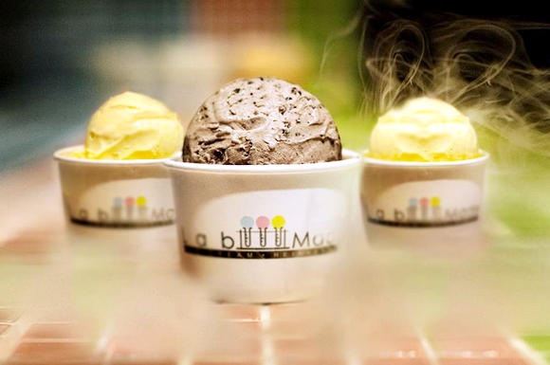

Slide 7
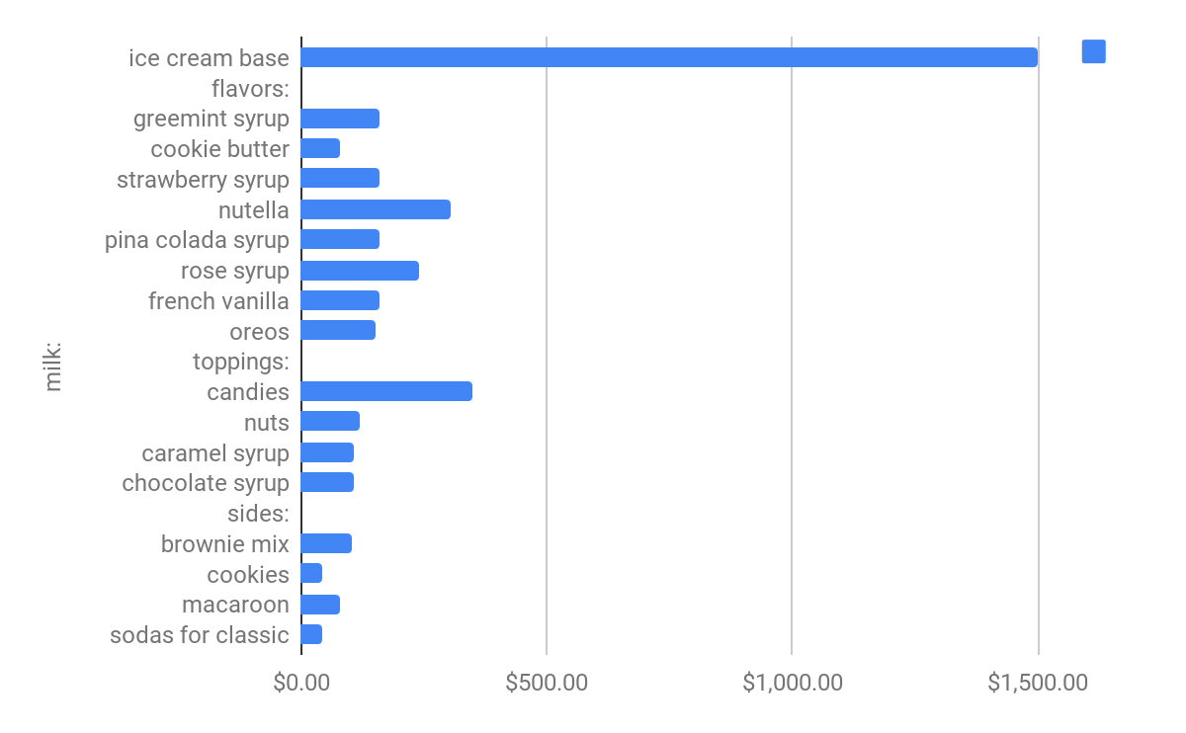
menu
Green Mint sides: Cookies, Brownie, Macaroon
Strawberry Topping: Syrups, mixed nuts, candies
Cookies n Cream
Rose
Chocolate hazelnut
French vanilla
Pina Colada
Cookie Butter

Slide 8
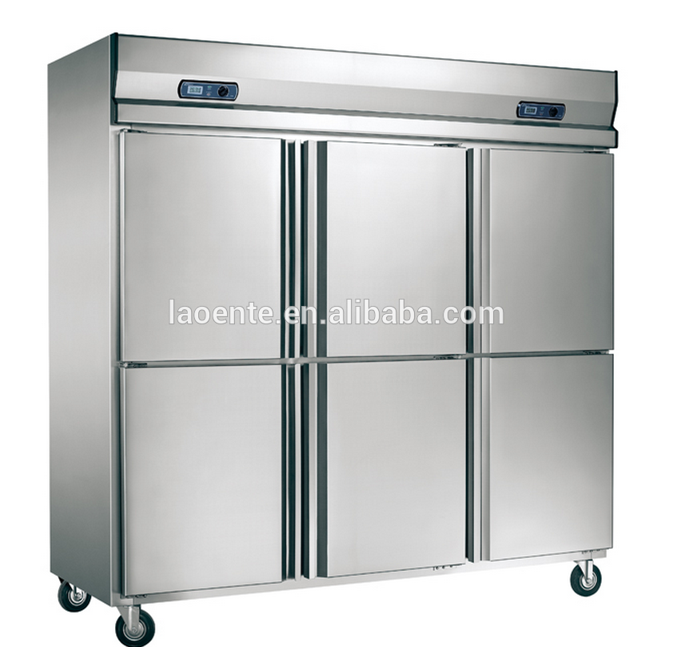
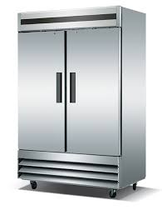
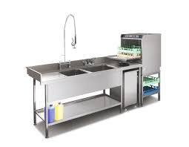
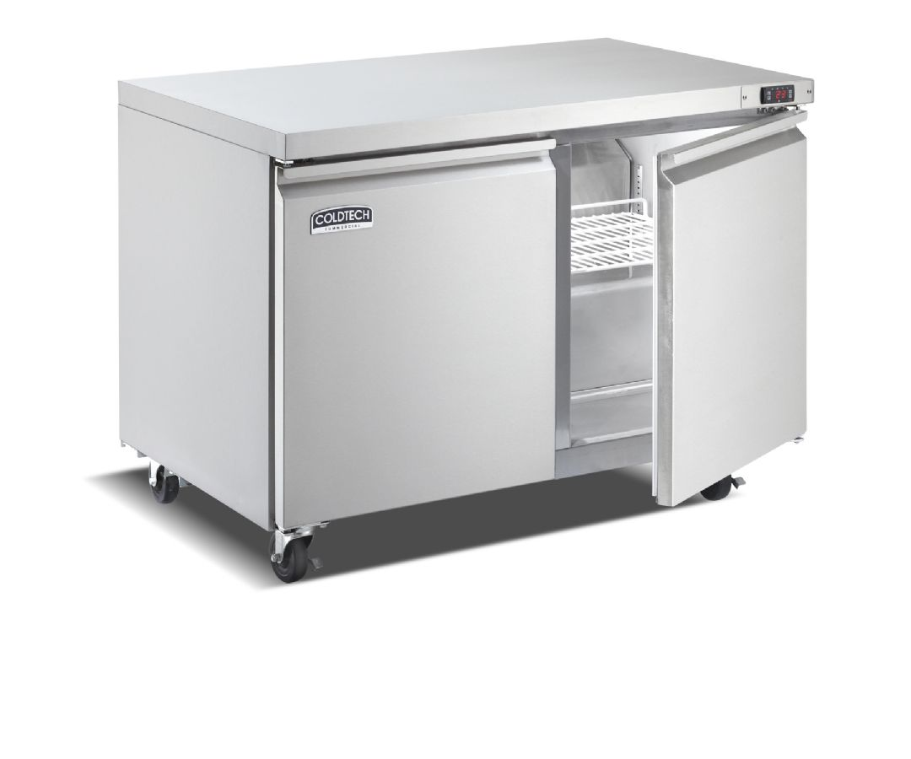
Equipment Cost
triple door freezer
double door refrigerator
Front of house-fridge
liquid nitrogen mixer
sanitizing station
mixing bowls (30*106/bowl)
Cups n lids(box contains 1400 cups)
Pos system
tables 8x
chairs 16x

Slide 9
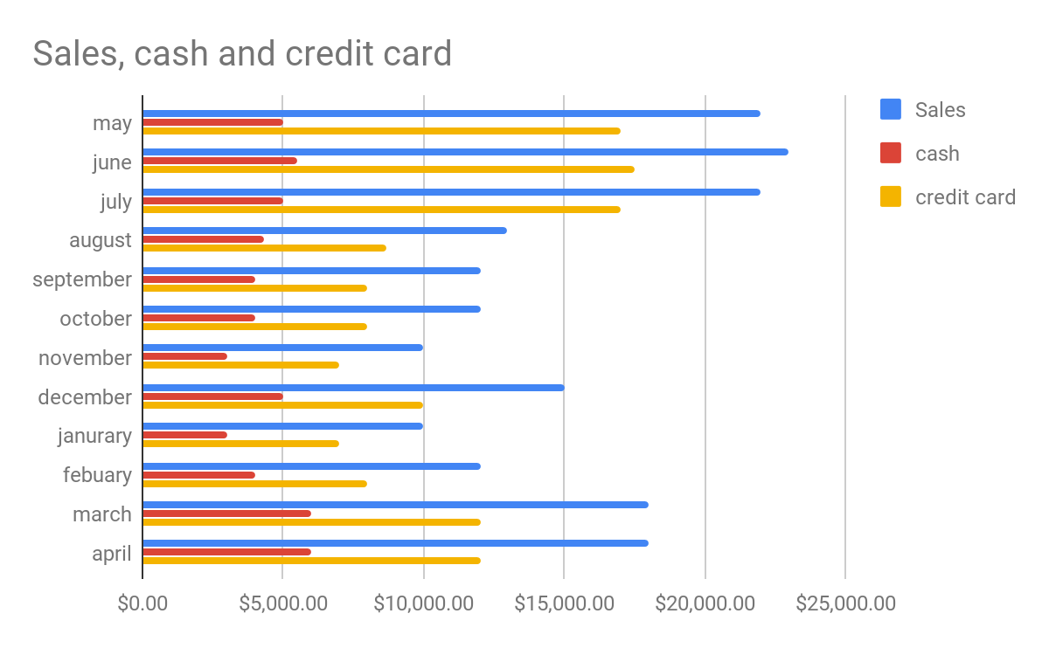
Purchases
As ice cream business is seasonal most of our purchases are going to be from April to August. Sales are slightly going to increases in december due to winter break .

Slide 10
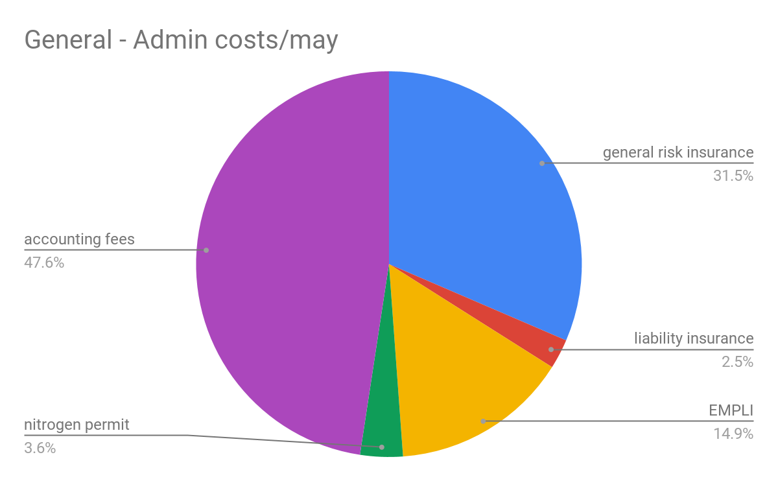
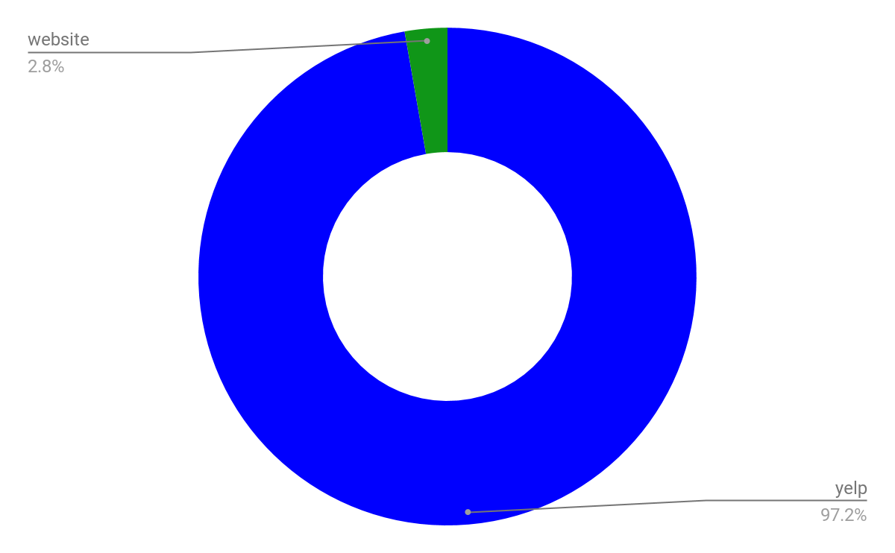
Selling general and administrative cost
General Admin cost Marketing Expense

